Slide 1
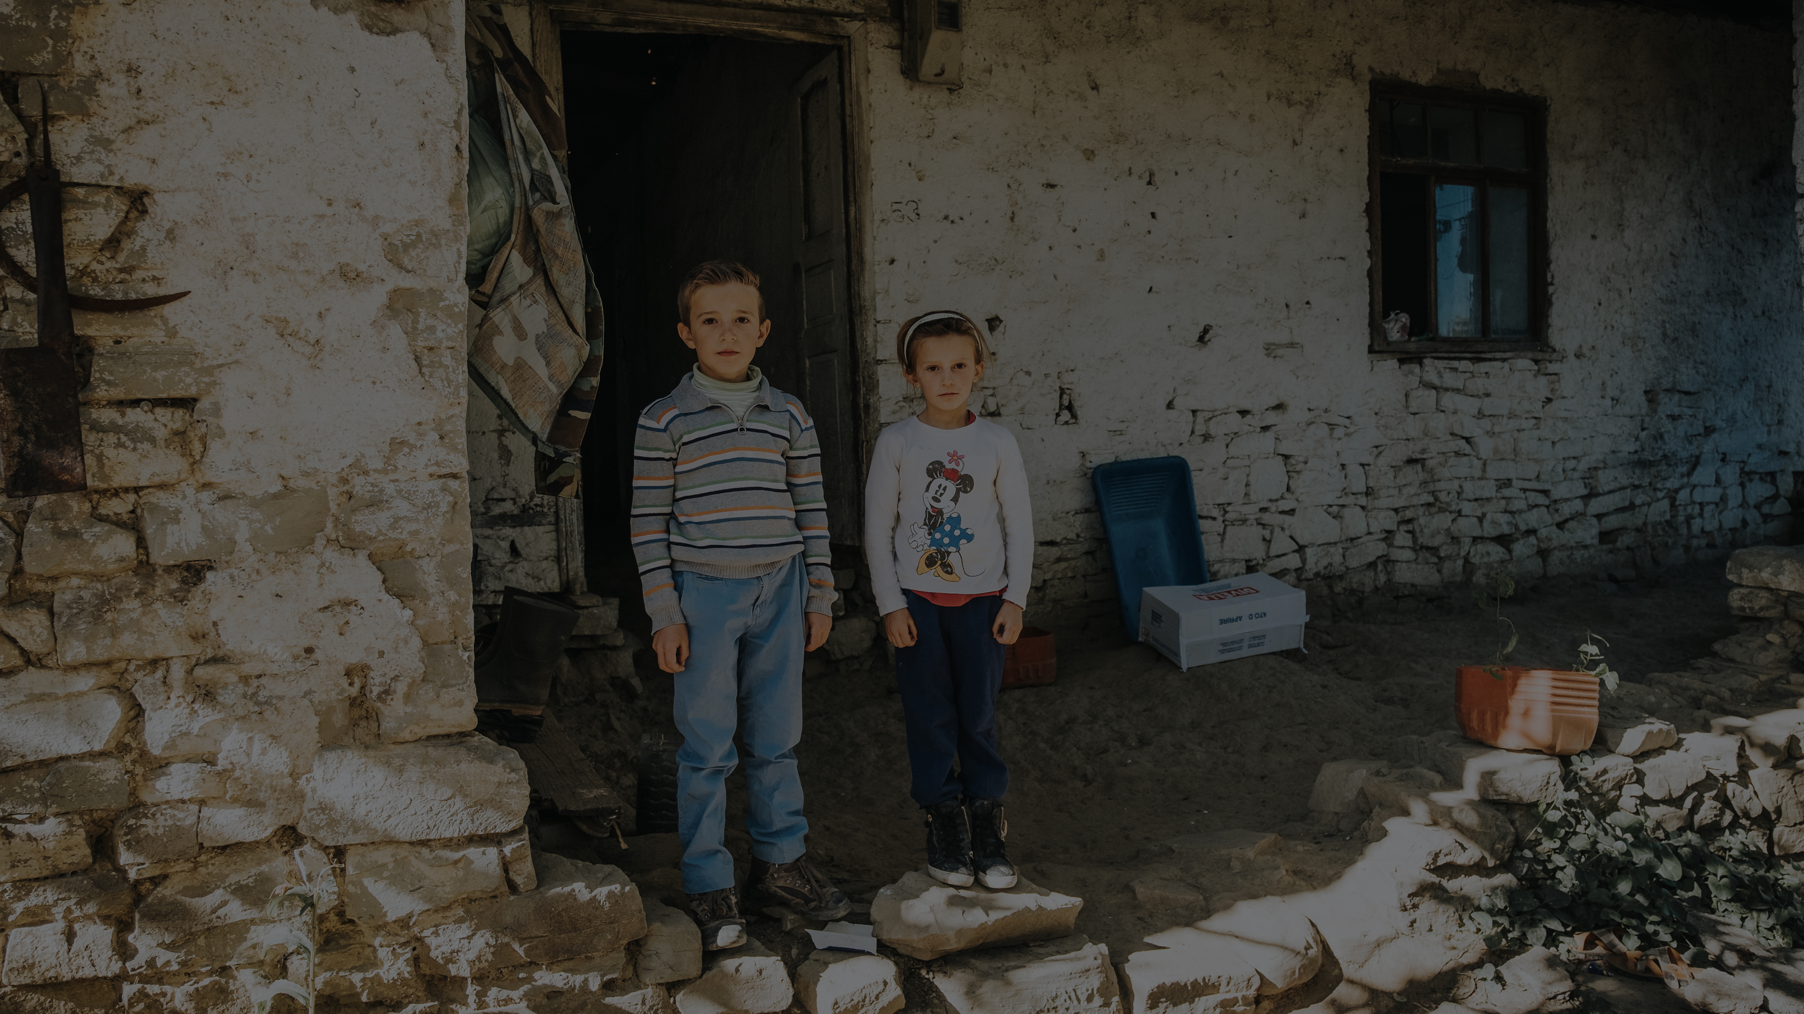
INTERNATIONAL DAY
OF PRAYER FOR THE PERSECUTED
CHURCH NAME HERE

Slide 2
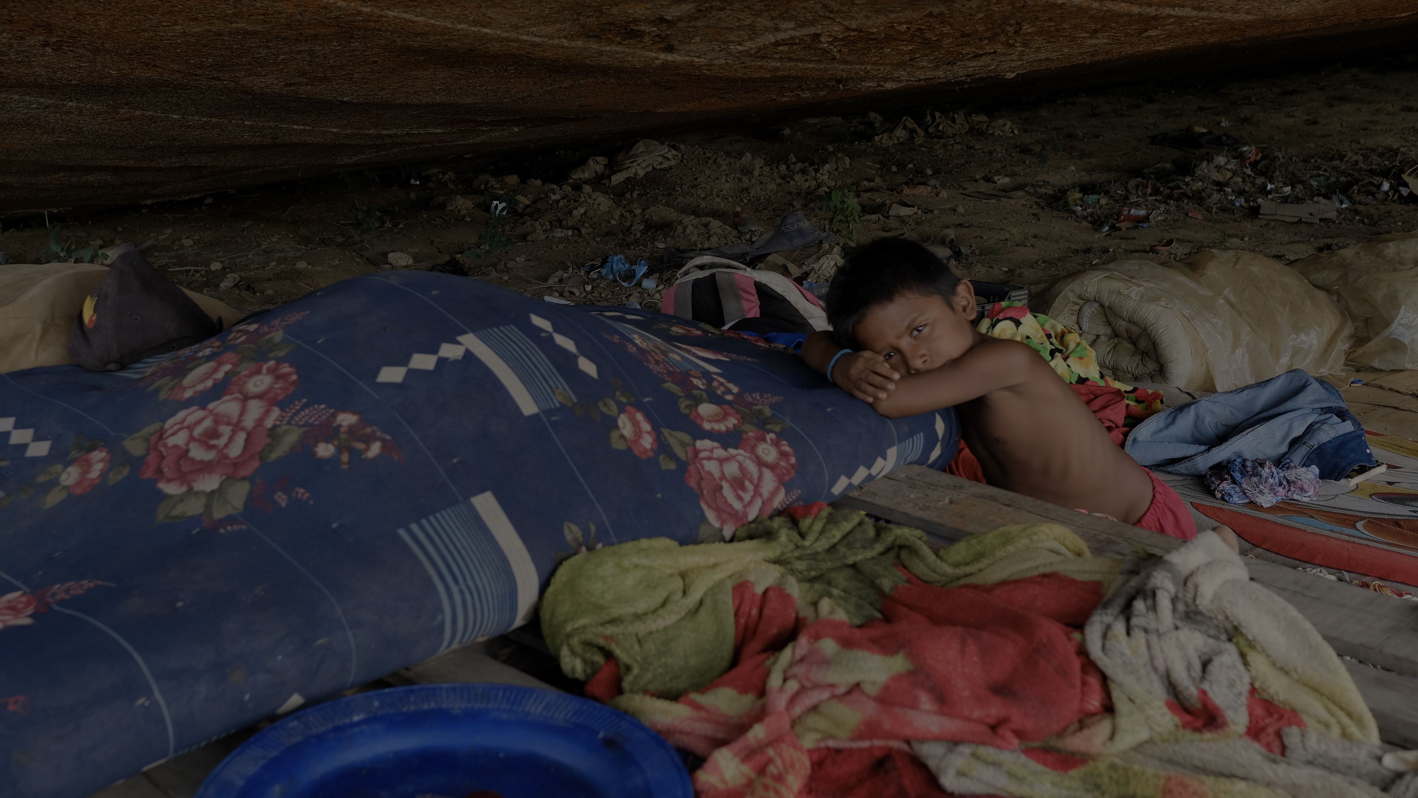
INTERNATIONAL DAY
OF PRAYER FOR THE PERSECUTED
CHURCH NAME HERE

Slide 3
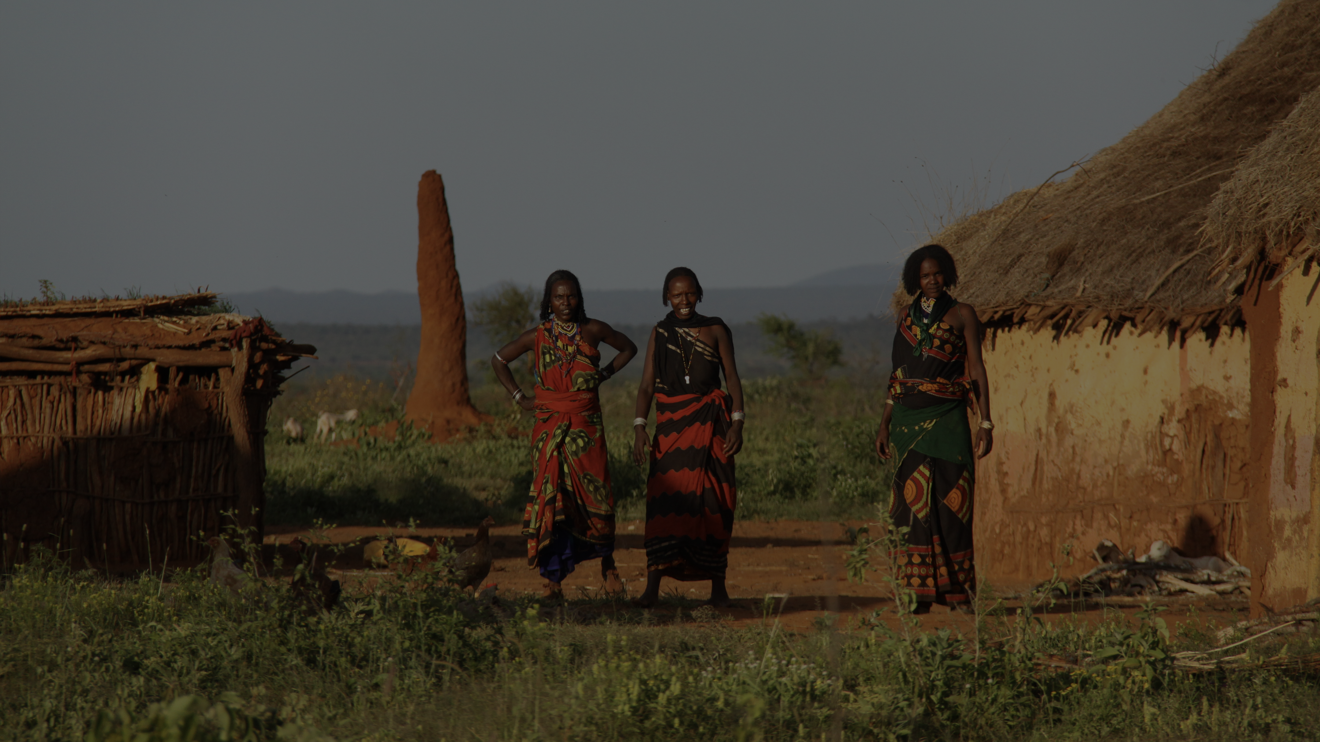
INTERNATIONAL DAY
OF PRAYER FOR THE PERSECUTED
CHURCH NAME HERE

Slide 4
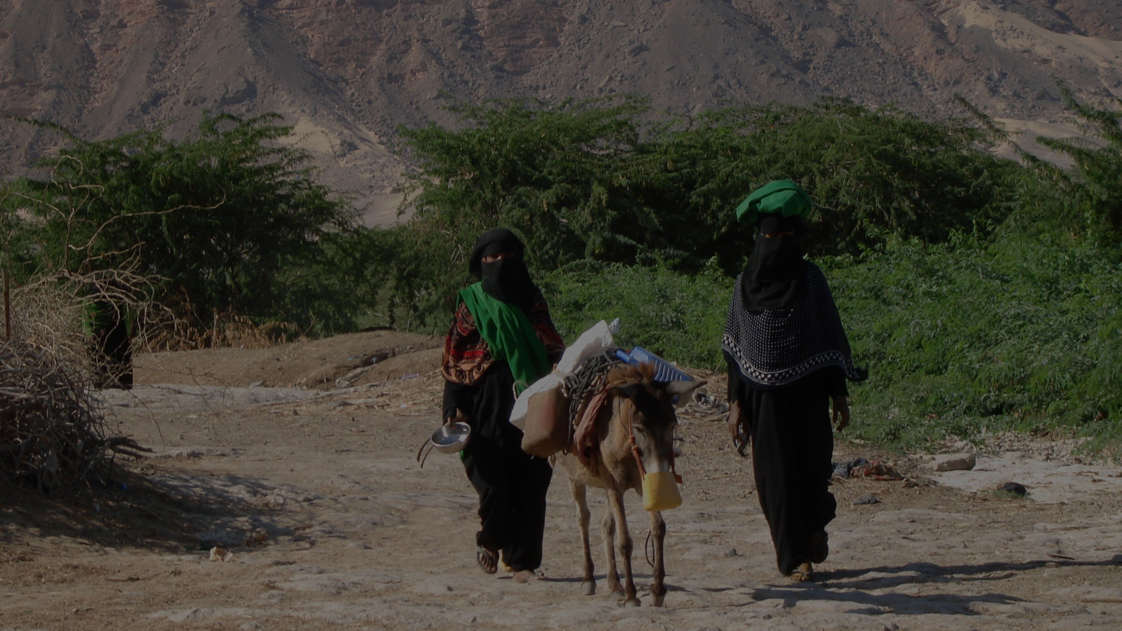
INTERNATIONAL DAY
OF PRAYER FOR THE PERSECUTED
CHURCH NAME HERE

Slide 5
HOW TO PRAY
Pray they will not feel alone or forgotten (Matthew 28:20).
Pray that God would knit your heart to theirs (1 Corinthians 12:26).
Praise God that those who are persecuted will have great reward
(Luke 6:22-23).
Pray for faithful perseverance (Hebrews 10:32-36).
Pray believers will be prepared for persecution (1 John 3:13).
Pray that Christians undergoing persecution will remember what they have learned so they stay faithful (2 Timothy 3:12-14).
INTERNATIONAL DAY OF PRAYER FOR THE PERSECUTED

